Slide 1
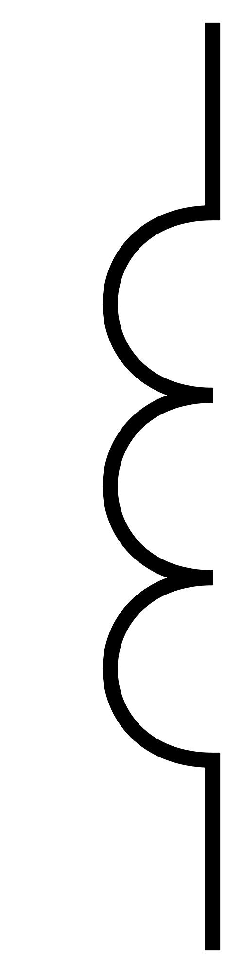
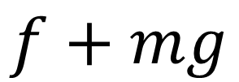

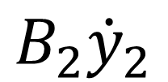



$$B_{2}{\dot{y}}_{2}$$
$$K_{1}\left(y_{1}−y_{2}\right)$$
$$B_{1}\left({\dot{y}}_{1}−{\dot{y}}_{2}\right)$$
M
$$f+mg$$
$$K_{1}\left(y_{1}−y_{2}\right)$$
$$B_{1}\left({\dot{y}}_{1}−{\dot{y}}_{2}\right)$$

Slide 2
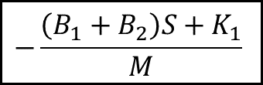
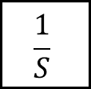
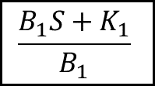
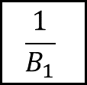
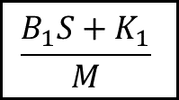
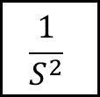
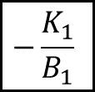

$$\frac{1}{B_{1}}$$
$$\frac{1}{S}$$
Y1
$$\frac{B_{1}S+K_{1}}{M}$$
$$\frac{1}{S^{2}}$$
Y2
$$F+mg$$
$$−\frac{K_{1}}{B_{1}}$$
$$−\frac{\left(B_{1}+B_{2}\right)S+K_{1}}{M}$$
$$\frac{B_{1}S+K_{1}}{B_{1}}$$

Slide 3
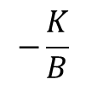










$$\frac{K}{J}$$
$$−\frac{K}{J}$$
$$\frac{K}{B}$$
$$\frac{1}{S}$$
$$T$$
$$θ_{2}$$
$$\frac{1}{J}$$
$$\frac{1}{S^{2}}$$
$$1$$
$$−\frac{K}{B}$$
$$θ_{1}$$

